Slide 1
Mobile App Performance Overview As of 1st June, 2024 To 1st August, 2024
Find a detailed report here (Power BI visuals)

Slide 2
MY OBJECTIVE
Examining...
Performance of user acquisition channels.
monetization trends & patterns.
Retention metrics across different networks, countries, and platforms.
-With an aim to identify key areas for improvement in user acquisition strategies and revenue optimization

Slide 3
HYPOTHESIS
UA Channel Performance:
Channels with higher spending may not always deliver higher ROI.
Certain networks or platforms are more cost-effective for acquiring high value users.
Revenue Trends:
Ad revenue and in-app purchase revenue (IAP) will vary significantly across geographies and platforms.
Retention Insights
Channels with higher retention rates drive higher revenue.

Slide 4
MY APPROACH
Exploratory Data Analysis In python
Data Visualization in Power Bi
focused on key performance indicators:
Revenue Generation (ARPU, Ad Revenue, IAP Revenue, Revenue trends)
UA Performance Metrics (CPI, CTR, CVR)
Channel Performance: (CTR, CVR, CPI, Installs, UA Spend, Revenue and ROI metrics.)
Retention to determine quality of our users (Retention D1/D7/D30)

Slide 5
KEY FINDINGS
I’ll walk you through three key areas:
Revenue Generation & Patterns—highlighting the financial outcomes.
User acquisition performance—examining the channels driving users take required action
Retention analysis—exploring how well users engage and contribute to revenue over time.

Slide 6
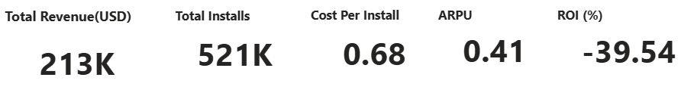
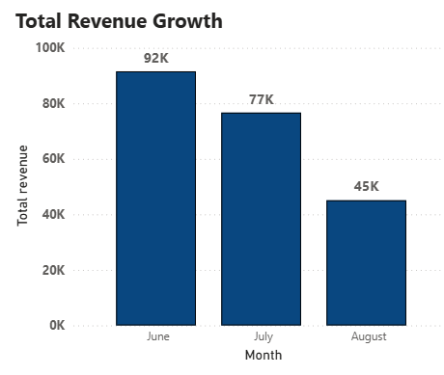
Recorded Revenue
O
Total Revenue: $213K June: Highest revenue ($92K) July: Decline to $77K August: Lowest at $45k Negative ROI shows we are incurring loss Further optimization in monetization is needed

Slide 7
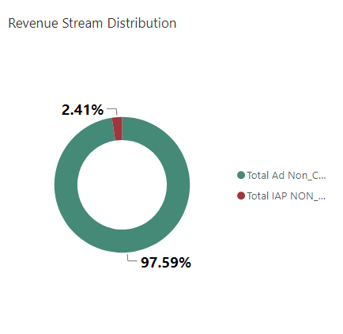
Revenue Generation Stream Distribution:
Ad Revenue Dominance: Ad revenue constitutes the vast majority of the revenue stream at 97.59%. This indicates a heavy reliance on ad-based income.
In-App Purchases (IAP): Contribute Only 2.41% of total revenue generated.
More balanced revenue model with additional IAP options will help improve profitability and diversify revenue streams

Slide 8
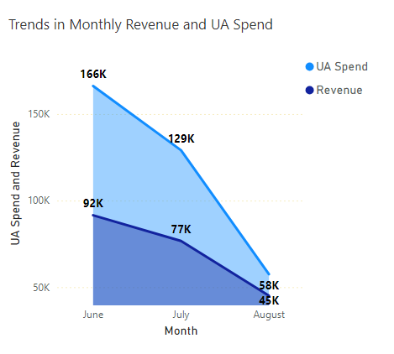
Trends In Revenue Generation vs UA Expenditure
Consistent Decline in UA Spend and Revenue Over Time:
The decline suggest it's either there is a pull-back in marketing efforts or seasonality
Revenue generation not sustainable
While UA Spend is consistently higher than the Revenue in each month, the gap between them is decreasing over time.

Slide 9
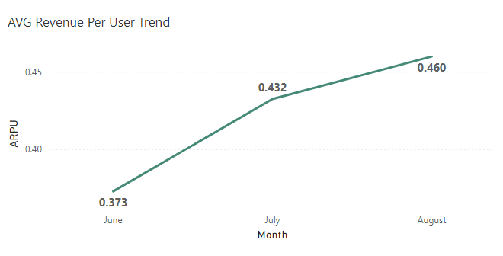
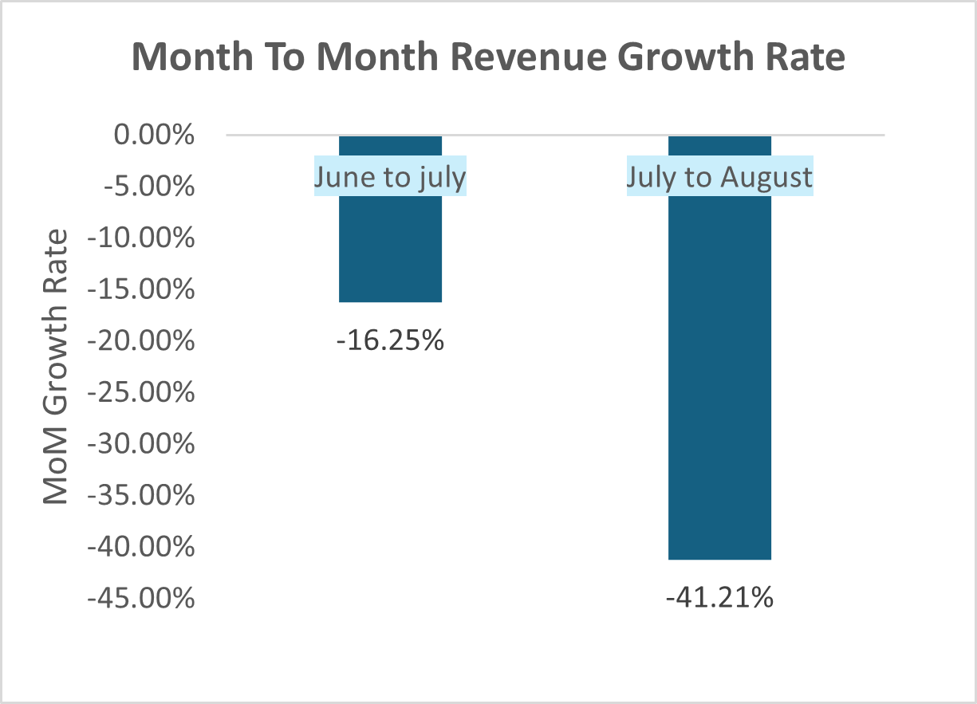
Average Revenue Per User
Increasing ARPU: Average revenue per user (ARPU) rose consistently from 0.373 in June to 0.460 in August, showing improved monetization per user.
Declining Revenue Growth Rate: Despite increasing ARPU, the month-over-month revenue growth rate dropped significantly, with a 16.25% decrease from June to July and 41.21% decrease from July to August.
The growth rate decline suggests a possible reduction in active user numbers or slower user acquisition, limiting total revenue growth despite higher revenue per user.

Slide 10
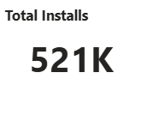
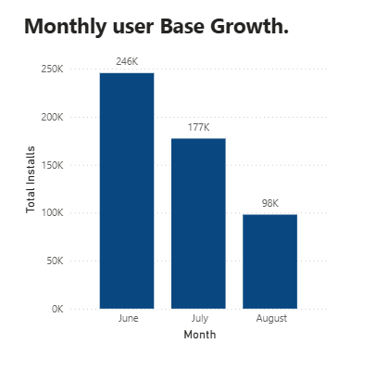
User Base Growth
Total Installs: 521K There’s a clear downward trend in new user installs from June to August: June to July: 28% decline. July to August: 44% decline.

Slide 11
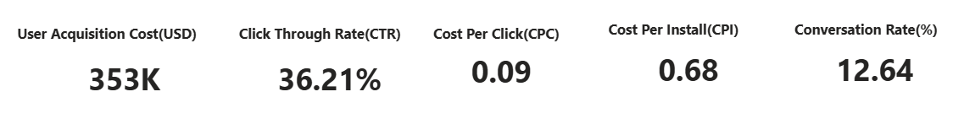
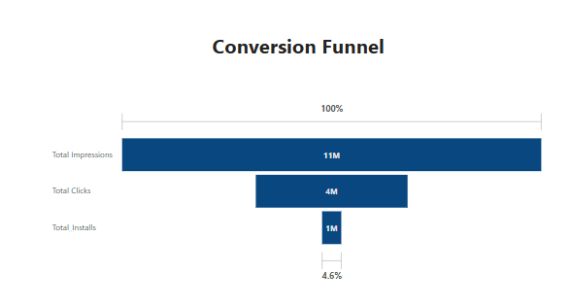
User Acquisition Funnel
-overall expenditure on acquiring users is $353K
-CTR is 36.21%, is quite high, suggests significant proportion of users who see the ads are clicking on them.
-Health conversion rate(12.64%)
-CPI IS high compared to ARPU

Slide 12
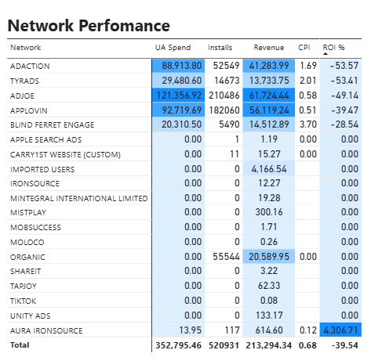
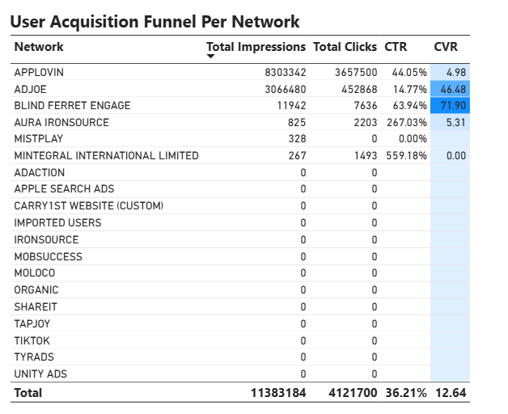
Network Performance

Slide 13
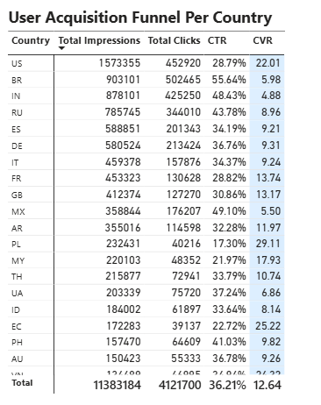
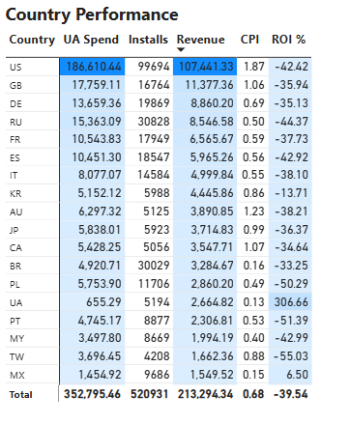
Country Performance.

Slide 14
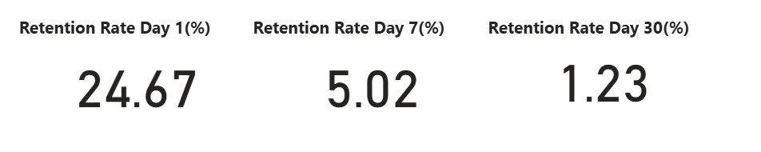
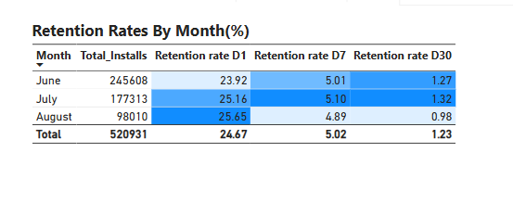
Retention Metrics
-Overall, retention decline sharply.
-Users lose interest after initial engagement period, we need stronger retention strategies

Slide 15
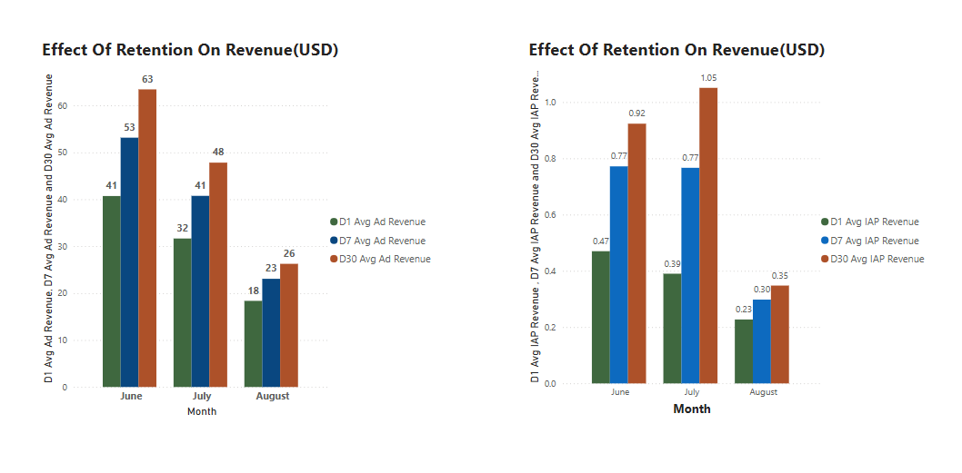
Impact Of Retention On Revenue
-Retention is a key driver for revenue growth.
-This suggest the quality user we are able to retain are loyal users

Slide 16
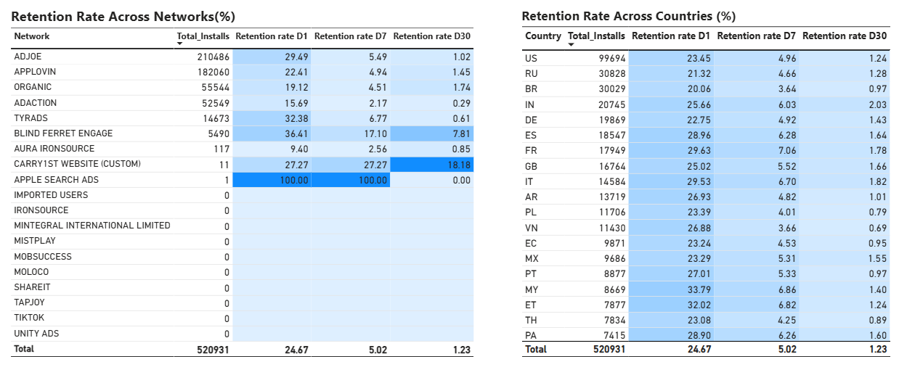
Retention Rate Across The different Networks & Countries

Slide 17
Summary
User acquisition efforts are bringing in users but need refine to convert more users and improve value we getting from a user and overall ROI .
Retention is critical to sustaining revenue growth, and strategies to improve long-term engagement should be a priority.
Diversifying revenue streams can reduce reliance on ads and improve profitability.

Slide 18
Recommendation
Focus on Conversion Optimization: For networks with high installs but low revenue, review user experience and conversion funnels post-installation. Identifying bottlenecks in the customer journey could increase monetization potential without needing additional spend.
Improve Ad Creatives and Messaging to optimize acquisition: Experiment with creative variations and messaging on underperforming networks to increase engagement and conversion rates. This might help increase the return without further increasing the ad spend.
Diversify Revenue Streams: Think of other monetization opportunities
Regularly Monitor and Adjust: Track each network's performance weekly or monthly. Identify trends early to make budget adjustments promptly, ensuring the best-performing networks receive an adequate budget while minimizing losses from low-performing ones
Launch engagement campaigns, such as push notifications, loyalty rewards, and personalized offers, to improve retention.
Find a detailed report here (Power BI visuals)

